Slide 1


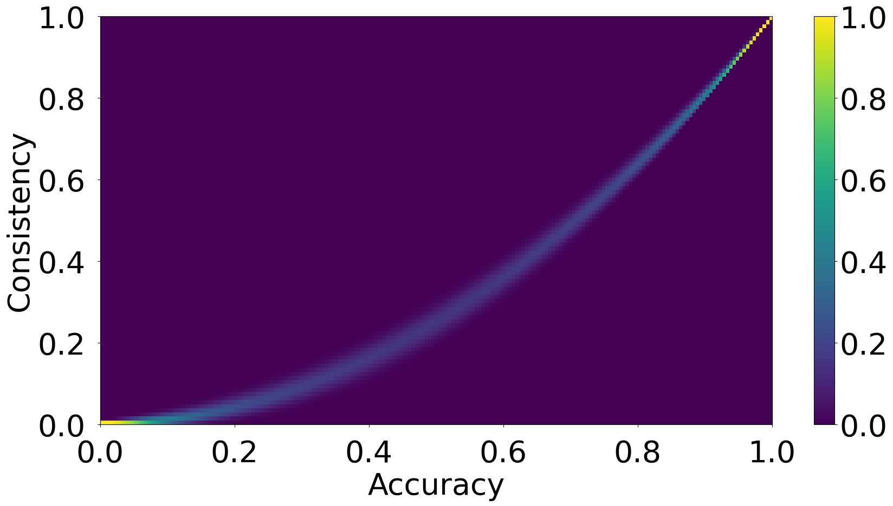
How Much Consistency Is Your Accuracy Worth?
Jacob Johnson Ana Marasović
UtahNLP, Kahlert School of Computing, University of Utah
jacob.k.johnson@utah.edu, ana.marasovic@utah.edu
Relative Consistency:
Introduction:
Recent works insightfully propose measuring model consistency alongside accuracy
They do not consider that increased accuracy naturally results in increased consistency
They do not address how to compare consistency across models with different accuracy
We present Relative Consistency to fill this gap
Calculation:
Builds on recent work measuring consistency in addition to accuracy
Enables comparison of consistency scores at different accuracies
Provides a probabilistic interpretation of model behavior
$a=\frac{45∨}{}$
$\frac{B∈3}{}$

